Slide 1
Church saves lives
A Medical-based Approach

Slide 2
Positive Patient outcome
Adolescent female patient
Would like to discontinue one of her medications
Would like to end therapy
I ask, “How are things going with your spirituality?”
Patient replies, “Dr. Schmitt, what I really need now is to get more involved in my church; church is very helpful for me.”

Slide 3
Religious upbringing and education
My Personal Belief
Raised in a Catholic family
Attended Catholic schools including medical school and general psychiatric residency
A faith-based approach was interwoven throughout my psychiatric/medical education and training.
I believe there is a divine spark in all of us simply needing to be either discovered or further amplified.

Slide 4
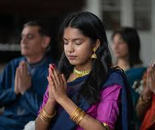
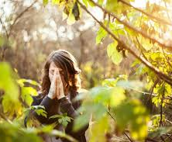
Initial interview questions r/t to spirituality
What gives you meaning in life?
What gives you purpose in life?
What do you believe your path in life is?
What do you want to be remembered for in life?
Do you believe in a higher-power?
If yes, do you attend faith-based services?
And if not, do you have philosophical beliefs?

Slide 5
Spirituality Examples:
AA
Mindfulness
Meditation
Connecting with nature
Community service
Creative practices
Reading
Finding meaning and purpose.

Slide 6
Foundations of Spiritual Psychology
Dr. Viktor Frankl
Dr. Frankl mentions his discovery of a page of the Jewish prayer, Shema Yisrael in the pocket of a garment he was given. This helped inspire him to keep praying and to continue to believe in God. Whenever he found an opportunity to pray or participate in makeshift religious service, he found the experience moving and inspiring.
“The religious interest of prisoners, as far, and as soon as it developed was the most sincere imaginable. The depth and rigor of religious belief often surprised and moved a new arrival. Most impressive in this connection were improvised prayers or services in the corner of a hut or in the darkness of the locked cattle truck in which they were brought back from distant, worksite, tired, hungry, and frozen in our ragged clothing .“
Holocaust survivor, neurologist, and psychiatrist
3 existential meanings in life:
Love for others, Love for his wife.
Need for achievement in life. He observed how people survived in concentration camps so he could lecture others about the Auschwitz experience and how to overcome despair.
Courage, honor, and dignity of the human spirit in the face of suffering including facing the end of life. He witnessed heroism and sacrificing in the concentration camp that led him to believe that people can endure any kind of suffering.
Notes:
A psychiatrist who was granted passage to America but chose to remain in Vienna with his family. He also chose numerous times to remain a prisoner in the concentration camp.

Slide 7
Foundations of Spiritual Psychology continued:
Dr. Martin Segliman
Psychologist
Focuses on the positive outlook, what can go right versus what can wrong.
In his book, Flourish: A visionary new understanding of happiness and well-being (2011), he wrote the well-being theory.
The 5 elements to well-being under the mnemonic, PERMA
Positive emotion
Engagement
Relationships
Meaning, and
Accomplishment.
There are strategies to increase each of these elements.
Notes:
Seligman, M. E. P. (2011). Flourish: A visionary new understanding of happiness and well-being. Free Press.

Slide 8
Undesired patient outcome
Unfortunately, there are many patients who have no spiritual or philosophical beliefs. For example, one patient does not see meaning in life and feels life is meaningless and is nihilistic. I have seen them for years and every time I see them, they deal with tremendous pain and suffering, and with that deep depression and anxiety, and sadly they do not wish to be alive.

Slide 9
Is there a correlation between these statistics?
March 2023 NORC Survey conducted with the University of Chicago a non-partisan research organization
Nursing Health Study published in JAMA Psychiatry
In 1998, 62% of Americans felt religion was very important as compared to 39% in 2023.
Patriotism went from 70% in 1998 down to 38% in 2023.
The importance of having children, community involvement, and hard work, all plummeted as well. The only indicator that went up was the importance of money which was sited as very important in 1998 at 31% and in 2023 went up to 43%.
40% increasing suicide risk in the United States from 1999 to 2014. This might be attributed to declines in attendance after religious services during this period.
28% of increase of depression among adolescence from 1991 through 2019.

Slide 10
The benefits of regularly attending religious services, according to JAMA (2022):
There was a major systematic review of the literature in 2022 in the Journal of American Medical Association documenting 215 studies each with sample size of over 1000 participants to evaluate the relationship between religion and health. The evidence from the metanalysis was that weekly religious service attendance is longitudinally associated with:
Lower mortality risk,
Lower depression,
Better cardiovascular disease survival,
Better health behaviors,
Greater marital stability,
Happiness, and
Purpose in life.

Slide 11
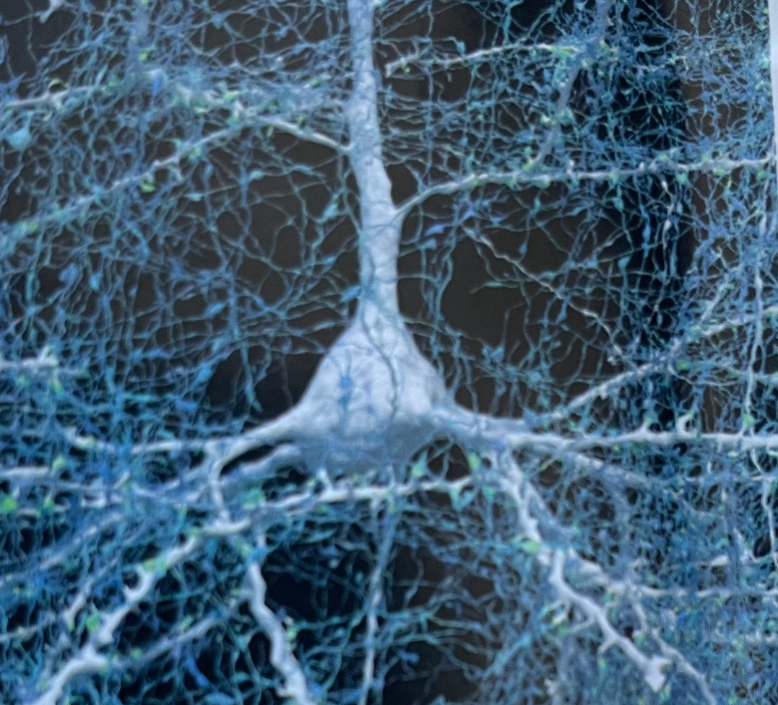
The connection between brain science and religious belief
Neurons fire together. The more you use a particular pathway of neurons, the more strongly they become connected to each other.
The human brain has an average of 86 billion neurons, a quadrillion synapses, and each neuron may have over 5,000 axons.
How do we as a church community become synapses in others’ lives?

Slide 12
Church saves lives
Questions:
Community & Purpose
How do we as a church community connect to others within our community?
How do we provide support?
How do we serve others?
How do we promote self-worth in others?
How do we encourage weekly attendance at church?
How do we help others to find their meaning and purpose in life?
“And let us consider how to stir up one another to love and good works, not neglecting to meet together, as is the habit of some, but encouraging one another, and all the more as you see the day drawing near.” Hebrews 10:24-25
“For I know the plans I have for you,” declares the Lord., “plans to prosper you and not to harm you, plans to give you hope and a future.” Jeremiah 29:11

Slide 13
Suggested reading list:
https://mind apps.org/ (all supported by the APA advisory board)
Calm (app)
BeMyEyes app for people who are blind
Man’s Search for Meaning by Dr Viktor Frankl
The World Could Be Otherwise by Norman Fisher
When You Greet Me, I Bow by Norman Fisher
Stoicism: How to Use Stoic Philosophy to Find Inner Peace and Happiness by Jason Hemlock
Seneca‘s, Letters From A Stoic
The Meditations of Marcus Aurelius Antoninus by Marcus Aurelius
The Ultimate Happiness Prescription 7 Keys to Joy & Enlightenment by Deepak Chopra
Metahuman by Deepak Chopra
Mindful Leadership by Maria Gonzalez
The Power of Now by Eckhart Tolle
Mindfulness An Eight Week Plan by Mark Williams
The Mindfulness Journal : Daily Practices, Writing, Prompts, and Reflections by Barry Davenport
A Mindfulness-Based Stress Reduction workbook by Bob Stahl
The Dialectical Behavioral Therapy Skills. Workbook: Practical DBT Exercises by Matthew McKay.
How to Do the Work . Recognize your patterns, heal from your path, and create yourself by Dr Nicole LePera
Exercise for Mood and Anxiety by Attorney & Smits
No Sweat by Sevareid

Slide 14
Dr. Viktor Frankl
Notes:
Can view at home

Slide 15
Dr. Martin Segliman
Notes:
Can view at home

