Slide 1
“Church* Saves Lives” (All faith communities save lives)
Emmanuel Church
October 23, 2024

Slide 2
Spirituality and the Wellbeing of Youth
“Raise up a child in the way he should go, and when he is old he will not depart from it.” Proverbs 22:6
“Let the little children come to me, and do not hinder them, for the kingdom of heaven belongs to such as these” Matthew 14:15

Slide 3
ELM at Yale
The Educational Leadership
and Ministry Program
“For leaders with faith, vision, and skill in the service of youth”

Slide 4
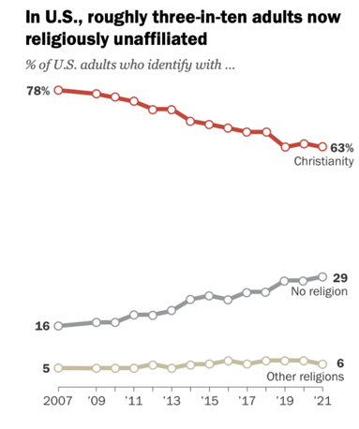
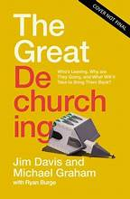

Slide 5
Hardwired to Connect: The New Scientific Case for Authoritative Communities

Slide 6
Hardwired to Connect The New Scientific Case for Authoritative Communities
Authoritative Communities: “groups of people who are committed to one another over time and who model and pass on at least part of what it means to be a good person and live a good life.”

Slide 7
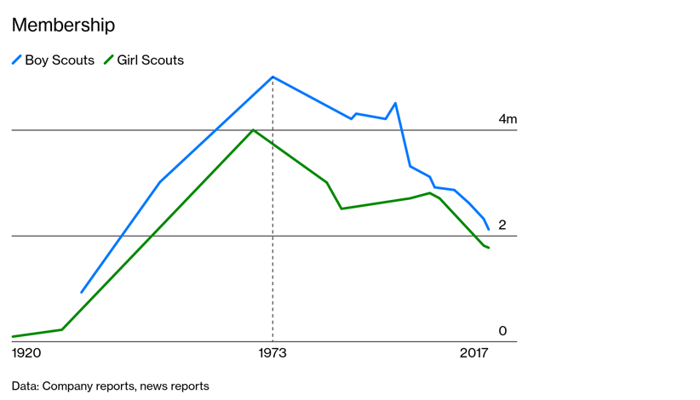

Slide 8
Health benefits for Teens of a robust spiritual life
Positive correlation
Enhanced coping skills
Self-esteem, resiliency
Strong Parent-child relationships
Negative correlation
Substance abuse
School deliquency
Self-harm

Slide 9
“. . . adolescents, [who are] hungry for meaning, benefit from positive role models, explicit discussion of moral values, and a community in which there are activities structured around prosocial values, including religious values.”

Slide 10
“No man is an island”

Slide 11
Moralistic Therapeutic Deism (MTD)
All God expects of me is to be a kind, decent person;
faith will help me feel better about myself; and
God is a distant being who rarely has a direct role in my life or expects any kind of difficult sacrifice from me.

Slide 12
from Hardwired to Connect: “if the current ecology of childhood is leading to a weakening of connectedness and therefore to growing numbers of suffering children, [then] building and renewing authoritative communities is arguably the greatest imperative that we face as a society.”

